Slide 1
Operating Systems

Slide 2
UNIT 3
Process Coordination

Slide 3
Principle of Concurrency
Ability to run multiple tasks or processes concurrently or simultaneously
Concurrency require multi-processor machine
It is different than parallelism wherein tasks are running in parallel but use of multi-processor machine is must

Slide 4
For synchronization purpose :- task or process must communicate with each other through IPC mechanism
Successful use of concurrency among processes requires the ability to define critical section/region and enforce mutual exclusion

Slide 5
Concurrent access to shared data may result in data inconsistency.
Maintaining data consistency requires mechanisms to ensure the orderly execution of cooperating processes.
Shared-memory solution to bounded-buffer problem allows at most n – 1 items in buffer at the same time. A solution, where all N buffers are used is not simple.

Slide 6
Synchronization problems
1. Readers-writer problem
2. Producer Consumer problem
3. Dining philosopher problem

Slide 7
Inter-process Communication
Process frequently need to communicate.
Ex. The output of first process must be passed to the second process.
No two or more processes should get in each others way.
Ex. Airline Reservation system.
Proper sequencing when dependencies are present.
Ex. Read from ADC then write to Display.

Slide 8
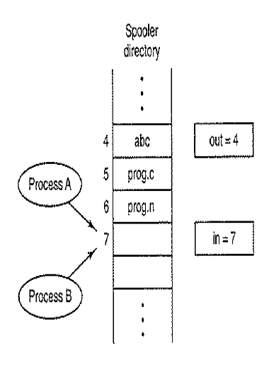
Race Condition
Situation where two or more processes are reading or
writing some shared data and the final result depends
on who runs precisely when are called race condition.

Slide 9
Critical Regions
The part of the program where the shared memory is accessed is called the critical region or critical section.

Slide 10
To avoid RACE condition
No two processes may be simultaneously inside their critical regions.
No assumptions may be made about speeds or the number of CPUs.
No process running outside its critical region may block other processes.
No process should have to wait forever to enter its critical region.

Slide 11
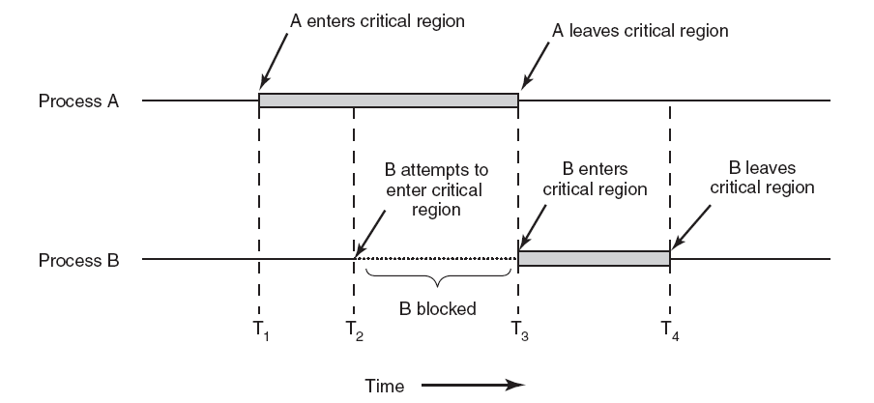
Critical Regions
Figure 2-22. Mutual exclusion using critical regions.

Slide 12
Race Condition
Race condition: The situation where several processes access – and manipulate shared data concurrently. The final value of the shared data depends upon which process finishes last.
To prevent race conditions, concurrent processes must be synchronized.

Slide 13
The Critical-Section Problem
n processes all competing to use some shared data
Each process has a code segment, called critical section, in which the shared data is accessed.
Problem – ensure that when one process is executing in its critical section, no other process is allowed to execute in its critical section.

Slide 14
Solution to Critical-Section Problem
1. Mutual Exclusion. If process P_{i} is executing in its critical section, then no other processes can be executing in their critical sections.
2. Progress. If no process is executing in its critical section and there exist some processes that wish to enter their critical section, then the selection of the processes that will enter the critical section next cannot be postponed indefinitely.
3. Bounded Waiting. A bound must exist on the number of times that other processes are allowed to enter their critical sections after a process has made a request to enter its critical section and before that request is granted.
Assume that each process executes at a nonzero speed
No assumption concerning relative speed of the n processes.

Slide 15
Initial Attempts to Solve Problem
Only 2 processes, P₀ and P₁
General structure of process P_{i} (other process P_{j})
do {
entry section
critical section
exit section
reminder section
} while (1);
Processes may share some common variables to synchronize their actions.

Slide 16
Mutual exclusion
It is a way of a making sure that if one process is using a shared variable or file , the other process will be excluded from doing the same thing.

Slide 17
It is a program object that prevents simultaneous access to a shared resource.
Concept used in concurrent programming by taking care of CRITICAL SECTION ( it is a piece of code in which processes or threads access a shared resource)

Slide 18
Arrange resources such that NO TWO PROCESSES EVER ENTER IN THEIR CRITICAL SECTION / REGION
(at the same time)

Slide 19
Mutual Exclusion Conditions
No two processes may at the same moment inside their critical section
No assumptions are made about relative speeds of processes or no of CPUs
No processes outside its critical region should block / occupy other resources/processes
No processes should wait long time to enter its critical section (discard)

Slide 20
Solutions
HARDWARE Support
OS Support (Semaphores and MUTEX)

Slide 21
Proposals for achieving mutual exclusion
Disabling interrupts
Lock variables
Strict alternation
Peterson's solution
The TSL instruction

Slide 22
Critical Section of n Processes
Shared data:
semaphore mutex; //initially mutex = 1
Process Pi: do { wait(mutex); critical section
signal(mutex); remainder section } while (1);

Slide 23
Disabling interrupts
Disable interrupt before entering in critical region
What will happen if process forget to enable interrupt?
What will happen in multicore environment?.

Slide 24
Lock variables
Use single , shared Lock variable.
Lock variable will be initially 0.
When process want to enter in critical region
It first test the lock.
If lock is 0,process set it to 1 and enters in
Critical region.
If lock is 1, process wait until it becomes 0.
Race around.
LOCK = 0 no process in critical region
LOCK = 1 process in critical region

Slide 25
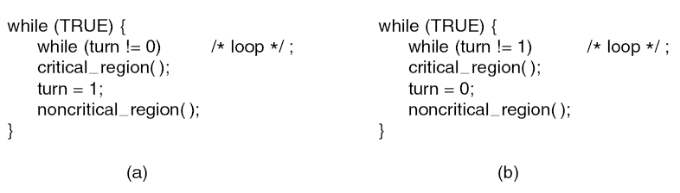
Strict Alternation
Spin lock problem ,wastage of CPU cycles.
A lock that is uses busy waiting is called a spin lock

Slide 26
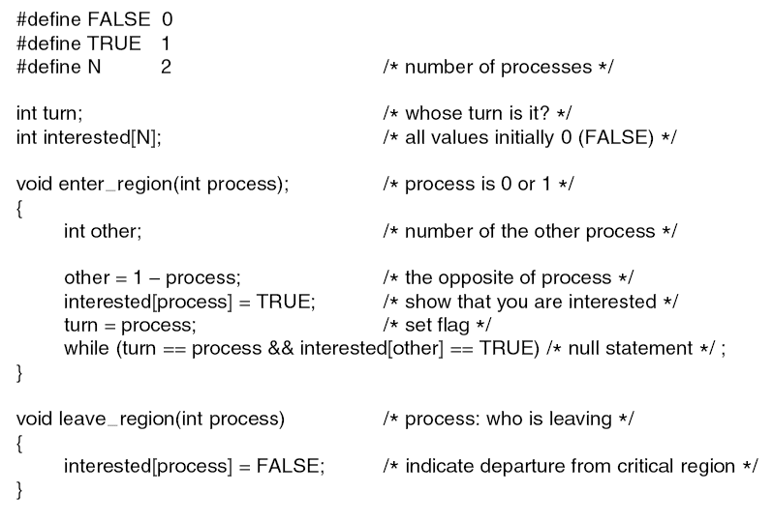
Peterson's Solution Peterson’s solution for achieving mutual exclusion : Multiple keys

Slide 27
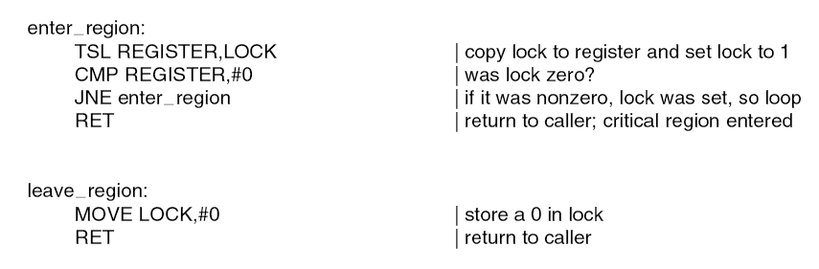
The TSL Instruction test and set lock
It reads a contents of memory word lock into register RX and store s a nonzero value at the memory address lock

Slide 28
Semaphores
Synchronization tool that does not require busy waiting.
Semaphore S – integer variable
can only be accessed via two indivisible (atomic) operations
wait (S):
while S≤ 0 do no-op; S--;
signal (S):
S++;

Slide 29
Wait : Decrement the value of its argument S as soon as it would become non-negative
Signal : Increment the value of its argument , S as an individual operation

Slide 30
Semaphore
New and significant technique for managing concurrent processes using VARIABLS called as SEMAPHORE
It is used to solve critical region problem & to achieve process synchronization in multi processing environment
Semaphore is an object that consists of counter , waiting list of processes ( and two methods WAIT and SIGNAL)

Slide 31
Types of Semaphore
Binary Semaphore (MUTEX)
Counting Semaphore

Slide 32
Properties of SEMAPHORE
Simple
Works with many processes
Can have many critical sections with diff semaphores
Each critical section has unique access semaphores
Can permit multiple processes into critical section at once if desirable (exceptional)

Slide 33
Used in 2 ways
Mutual exclusion
condition synchronization

Slide 34
Limitations / drawbacks
Priority inversion is big limitation
Its use is not enforced but is by convention only
With improper use a process may block indefinitely
Access to semaphore can come from anywhere in a program
No control or guarantee of proper usage
No linguistic connection between semaphore and data to which semaphore controls some access

Slide 35
MUTEX
Used to ensure only one thread at a time can access resource protected by mutex
Easy and efficient for implementation
Can be one of two states : Locked or Unlocked
Represented by one bit : zero (0) means unlock and any other value means

Slide 36
When a process needs access to critical section it checks condition of MUTEX_LOCKS
If it is currently UNLOCKED then calling process enters in critical section

Slide 37
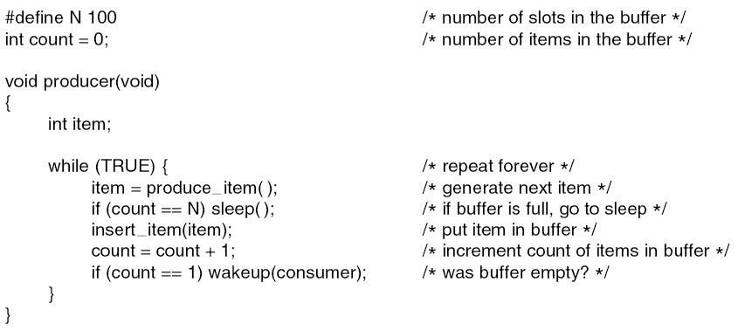
The Producer-Consumer Problem (1)
Read ADC and Display Routine problem.
. . .

Slide 38
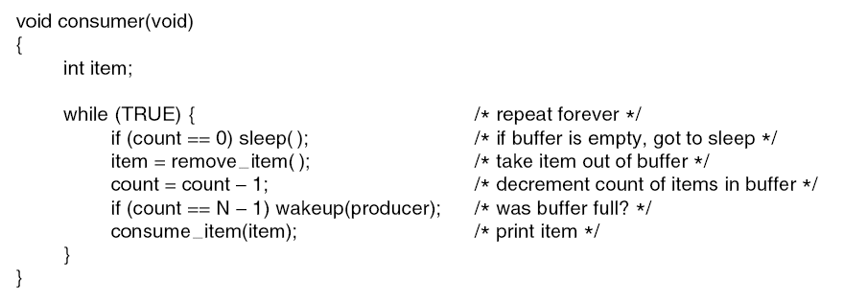
The Producer-Consumer Problem (2)
. . .
Figure 2-27. The producer-consumer problem with a fatal race condition.

Slide 39
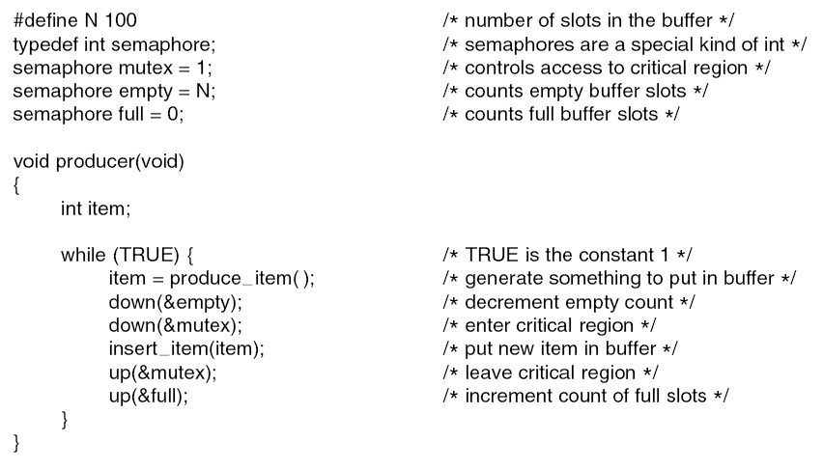
Semaphores (1)
. . .

Slide 40
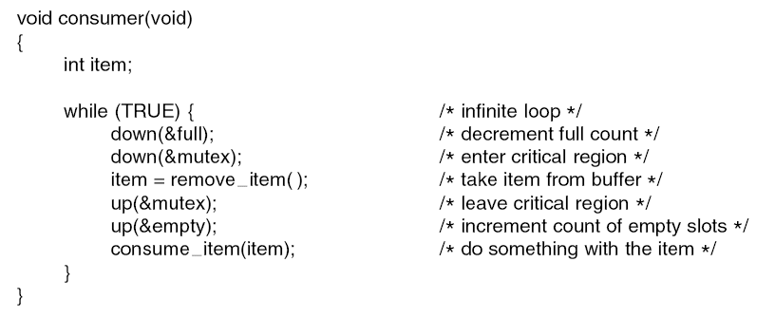
Semaphores (2)
. . .
Figure 2-28. The producer-consumer problem using semaphores.

Slide 41
Classical Problems of Synchronization
Synchronization problems are present as example of a large class of concurrency-control problems.
These are used for testing newly proposed synchronization scheme. We use semaphores for synchronization.

Slide 42
1. Readers – Writers
2. Producer Consumer Problem
3. Dining Philosopher Problem

Slide 43
Readers writers problem
Database is shared among several concurrent processes
Some pro may want only to read the database while others may need to update the same
Former : Reader
Latter : Writer

Slide 44
If two readers access the shared data simultaneously , no effect but if one or two writers access the database , it may create problem
Many readers may access the object concurrently , but if a writer is accessing the object no other process may access the object

Slide 45
First Readers Writers Problem
Readers have priority over writers
Here writer may need to wait for a long time also

Slide 46
Second Readers Writers Problem
Writers have priority over readers
When a writer wants to access the object , only readers which have already obtained permission to access the object are allowed to complete their access. Any reader requesting access after writer must wait until writer is finishing the task
Reader may need to wait

Slide 47
Producer Consumer Problem
Two processors :
ONE is PRODUCER
OTHER is CONSUMER
Both run concurrently and share a common buffer
Producer generated items are consumed by customer

Slide 48
Dining Philosopher Problem
They share a circular table surrounded by 5 chairs
At the centre 5 resources
If resources are being used by another process , other process becomes helpless to use required resource

Slide 50
Preemptable and Nonpreemptable Resources
Sequence of events required to use a resource:
Request the resource.
Use the resource.
Release the resource.

Slide 51
Conditions for Resource Deadlocks
Mutual exclusion condition
Each resource is either currently assigned to exactly one process or is available.
2. Hold and wait condition.
Process currently holding resources that were granted earlier can request new resources.
No preemption condition.
Resources previously granted cannot be forcibly taken away from the process.
Circular wait condition.
each one is waiting for a resource held by the next member.

Slide 52
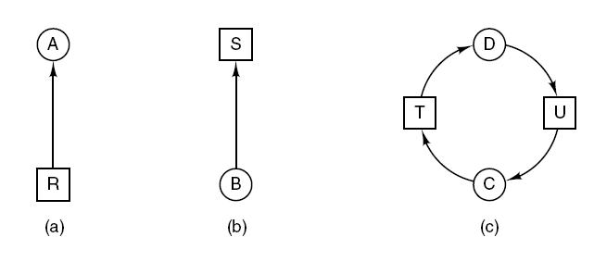
Deadlock Modeling (1)
Figure 6-3. Resource allocation graphs. (a) Holding a resource. (b) Requesting a resource. (c) Deadlock.

Slide 53
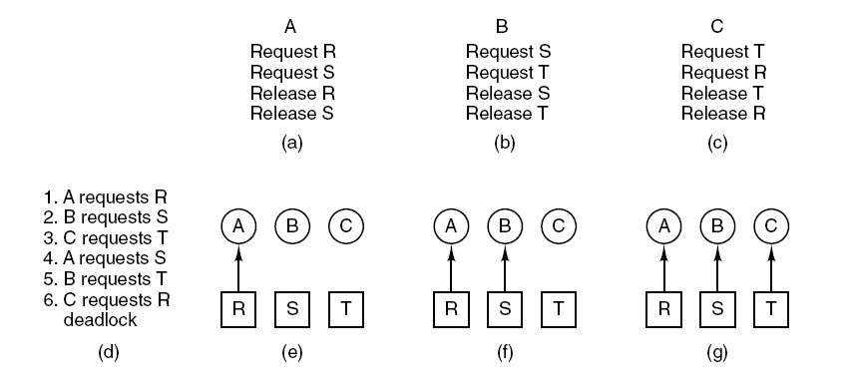
Deadlock Modeling (2)
Figure 6-4. An example of how deadlock occurs and how it can be avoided.

Slide 54
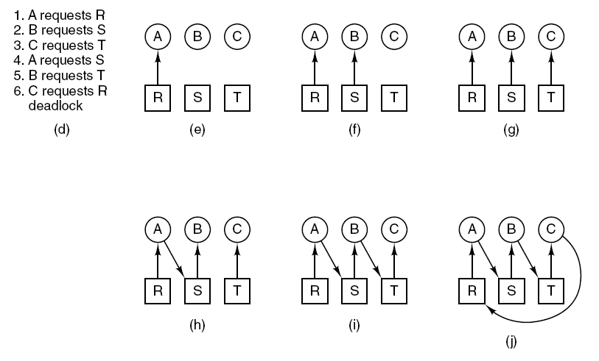
Deadlock Modeling (3)
Figure 6-4. An example of how deadlock occurs and how it can be avoided.

Slide 55
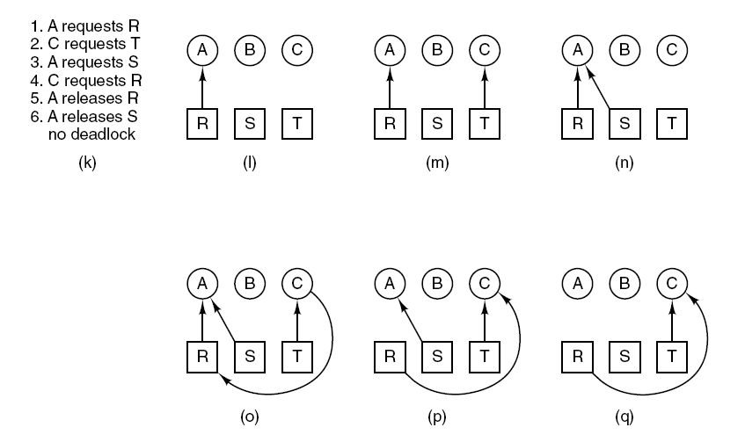
Deadlock Modeling (4)
Figure 6-4. An example of how deadlock occurs and how it can be avoided.

Slide 56
Deadlock Modeling (5)
Strategies for dealing with deadlocks:
Just ignore the problem.
Detection and recovery. Let deadlocks occur, detect them, take action.
Dynamic avoidance by careful resource allocation.
Prevention, by structurally negating one of the four required conditions.

Slide 57
Ostrich algorithm

Slide 58
Recovery from Deadlock
Recovery through preemption
Recovery through rollback (check point)
Recovery through killing processes

Slide 59
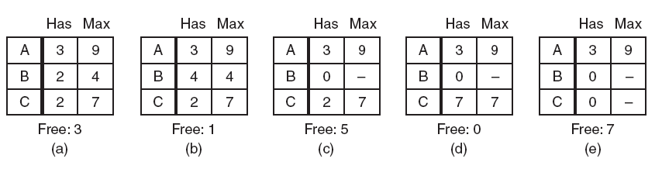
Safe and Unsafe States (1)
Figure 6-9. Demonstration that the state in (a) is safe.

Slide 60
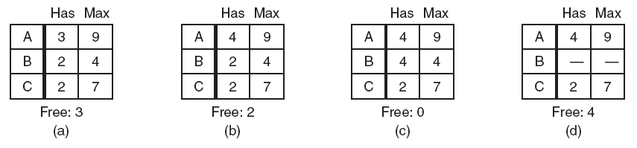
Safe and Unsafe States (2)
Figure 6-10. Demonstration that the state in (b) is not safe.

Slide 61
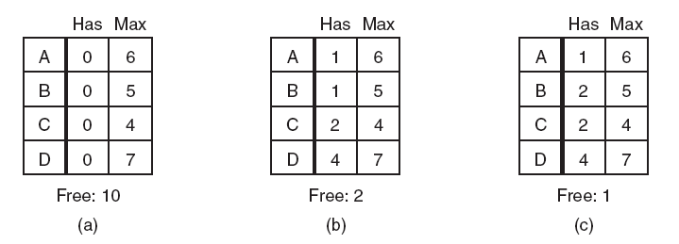
The Banker’s Algorithm for a Single Resource
Figure 6-11. Three resource allocation states: (a) Safe. (b) Safe. (c) Unsafe.

Slide 62
Deadlock Prevention
Attacking the mutual exclusion condition
Attacking the hold and wait condition
Attacking the no preemption condition
Attacking the circular wait condition

Slide 63
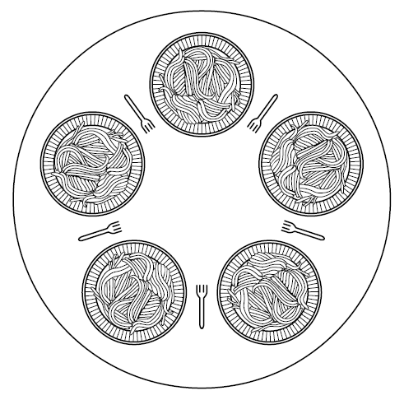
Dining Philosophers Problem (1)
Figure 2-44. Lunch time in the Philosophy Department.

